Slide 1


MEDICAL STORE MANAGEMENT SYSTEM
PRESENTED BY:
Kriti Khadka Chhetri
Purnima Sigdel
Vyshnavi Chhetri

Slide 2


INTRODUCTION
A medical store management system is a software application designed to help pharmacy or a medical stores run smoothly and efficiently. It helps to replaces manual ways of managing the store .This system is developed to maintain records of medicines and stock levels.

Slide 3


MOTIVATION
After doing research, we got fascinated to do a mini project on this topic using C language by implementing an automated system which can streamline the day-to-day operations of a medical store efficiently. The real motive to make the medical management system is to make it more secure and trustworthy which reduces number of errors in medical field.

Slide 4


The existing medical store management system lacks efficient management of medicines and medicine records on paper-based is becoming complex due to manual process such as poor record keeping ,error in calculation, inaccurate stock levels that is why we built this system.
STATEMENT OF PROBLEMS

Slide 5

OBJECTIVES
Provides a systematic medicine management.
To implement digital system for accurate and secure record keeping.

Slide 6
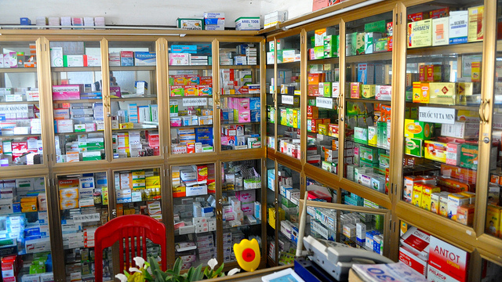

APPLICATIONS
This medical store management system is used in pharmacy or in a medical store. By using this system, store owner or pharmacists can reduce medication errors, improves workflow and it is designed in such a way that it is user friendly.

Slide 7


SCOPE OF MEDICAL STORE MANAGEMENT SYSTEM
a. The detail of medicine which is available in medical store is easily managed and organized by using this system.
b. This system helps in analyzing the location of the specific medicine available in the medical store.

Slide 8
TIME SCHEDULE AND ACTIVITIES OF GROUP MEMBERS
Name | Role | Activities | Working days of maximum 35 days
Kriti Khadka Chhetri | Team leader ,designer, coder and documentation | Develop project plan, design and write a code according to the project requirements and documentation. | 35 days
Purnima Sigdel | Coder, designer and documentation | Design, Write code according to project requirements and documentation | 35 days
Vyshnavi Chhetri | Programmer ,designer and documentation | Design, write a code according to project requirements and documentation. | 35 days

Slide 9
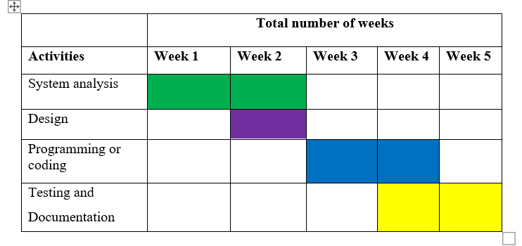
WORK SCHEDULE (GANTT CHART)

Slide 10
ALGORITHM
The algorithm of Medical Store Management system given below:
Step 1: Start
Step 2: Enter login credentials.
Step 3: Check whether the login Id is valid or not.
If yes, go to step 4.
If no, display wrong password go to step 2.
Step 4: Display menu options for the user:
1. Add new medicine
2. Purchase/sales medicine
3 .Delete medicine
4. Search for medicine
5. Display all medicines
6. Exit
Step 5: Enter your choice.
Step 6: If choice equals to 1 ,add new medicine and goto step 7.
If choice equals to 2, purchase/sales medicine and goto step 8.
If choice equals to 3, delete medicine and goto step 9.
If choice equals to 4, search for medicine and goto step 10.
If choice equals to 5, display all medicine and goto step 4.
If choice equals to 6, exit
If no, display invalid input and go to step 4.
Step 7: Enter id, name, quantity, price and rack and goto step4.
Step 8: Press 1 for purchase medicine and 2 for sales medicine and goto step 4.
Step 9: Enter id to delete medicine and goto step 4.
Step 10: Enter id to search medicine and goto step 4.
Step 11: Stop

Slide 11
FLOWCHART
Start
Enter login credentials
Is login valid?
Wrong password
NO
YES
Display menu options
1.Add new medicine
2.Purchase/sales medicine
3.Delete medicine
4.Search for medicine
5.Display all medicines
6.Exit
Enter your choice
B
A
C

Slide 12

B
A
c
Is choice equal to 1?
YES
Add medicine
NO
Is choice equal to 2?
Purchase/sale medicine
1.Purchase medicine
2.Sale medicine
YES
NO
YES
Enter your choice
Is choice equal to 1?
YES
1. Purchase medicine
NO
2. Sales medicine
B
C

Slide 13
B
A
C
Is choice equal to 3 ?
YES
Delete medicine
NO
Is choice equal to4 ?
YES
Search for medicine
NO
B
A
C

Slide 14
B
A
C
Is choice equal to 5?
YES
Display all medicine
NO
Is choice equal to 6?
Display invalid input
NO
YES
Exit
End

Slide 15

CONCLUSION
In conclusion, the Medical Store Management system is an automated system aims to meet the requirements of medical stores by efficiently storing and managing their valuable data and information. It offers a secure login system. This Medical store Management System has many features such as adding new medicine, updating medicine, searching ,deleting & displaying records of medicine. This system will allow users to perform above mentioned operations in order to maintain the medical store in a convenient and more secure way.

Slide 16
Thank
You

